Slide 1
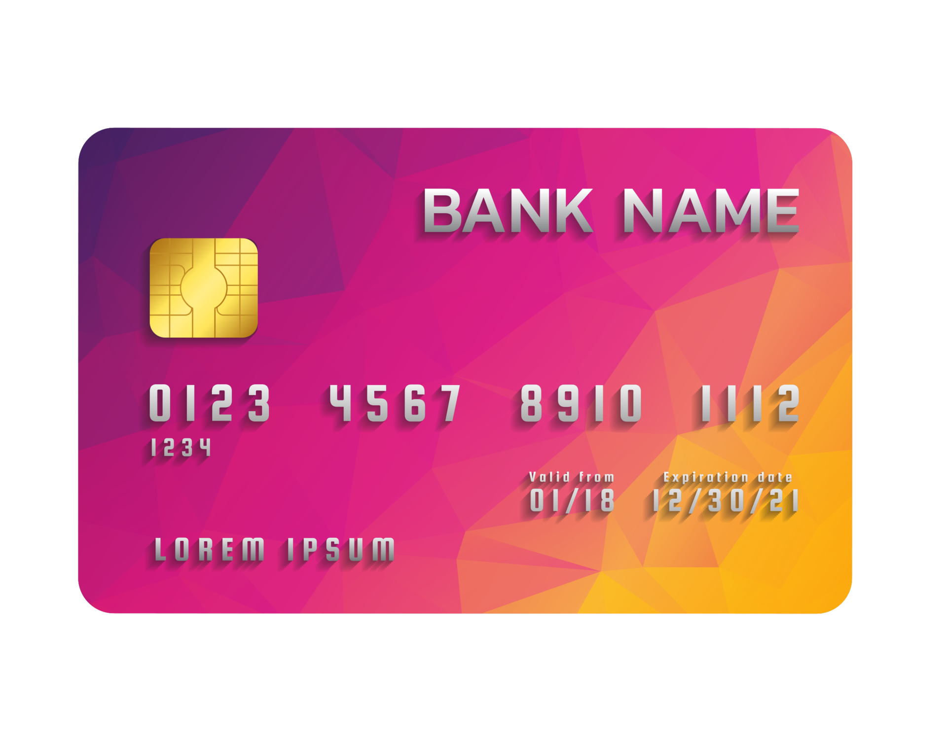
Royal Bank of GIES
Predicting customer churn
Group D9

Slide 2




Group Members
Aditya Bansal
Yijing Huang
Riley Ma
Palak Nath
MSBA
MSA
MSA
MSBA

Slide 3
Background
There is a lot of competition between different credit card companies these days. Each company is trying to offer the best of the services and trying to become the monopolist in the market. But due to the recent trends in the market and also because of the COVID aftermath a lot of people are paying attention towards their finances more keenly. The bank's manager is concerned that more and more consumers are abandoning their credit card services. They would definitely like it if someone could foresee who was going to leave so they could reach out to them in advance, improve their services, and influence customers' decisions.

Slide 4
How can banks determine which customers will churn?
What can the banks do to retain their customers?
Customer Churn Analysis in Banking Sector

Slide 5
About the Data
10k Rows and 21 Columns
18 Features
Source: Kaggle.com
Size: 1.51 MB
DV:Attrition_Flag
Sector: Banking/Marketing
Data Link: https://www.kaggle.com/datasets/sakshigoyal7/credit-card-customers

Slide 6
Introduction to Data
Under COVID, people focus more on their finances
Competition between different credit card companies
Trying to become the monopolist in the market
The meaning of the dataset
Managers’ worries: People abandon credit card services.
Foresee the leaving in advanced and improve their service to influence customers’ decisions.

Slide 7
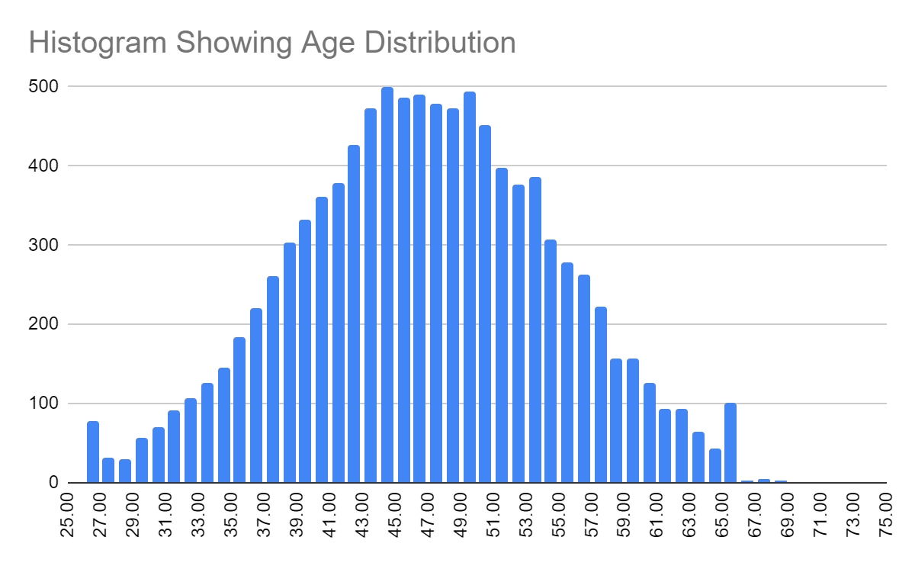
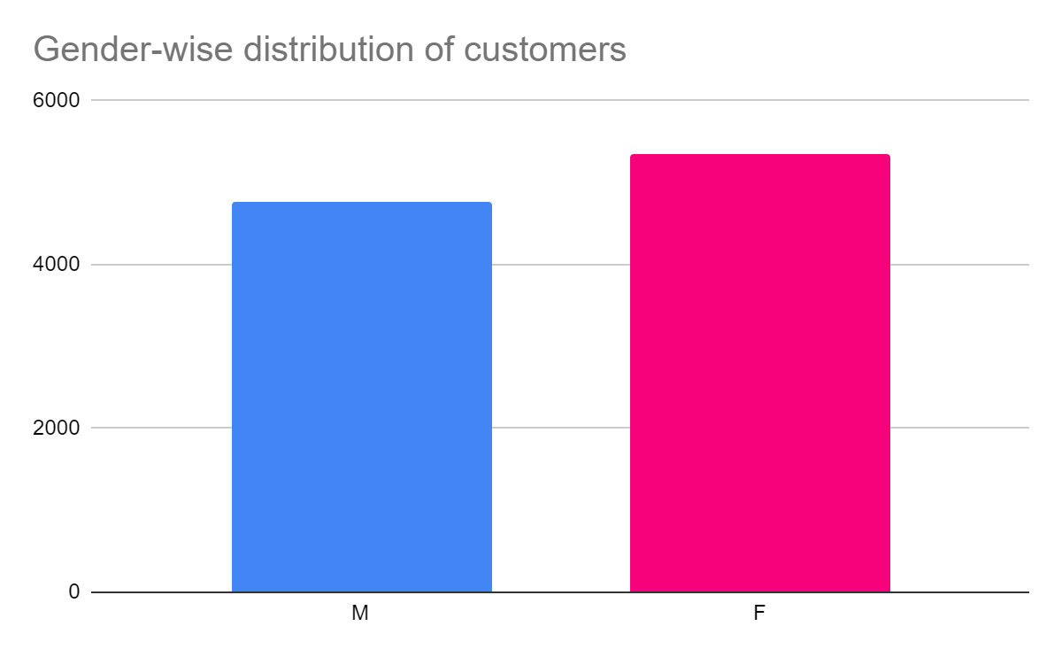
Data Exploration

Slide 8
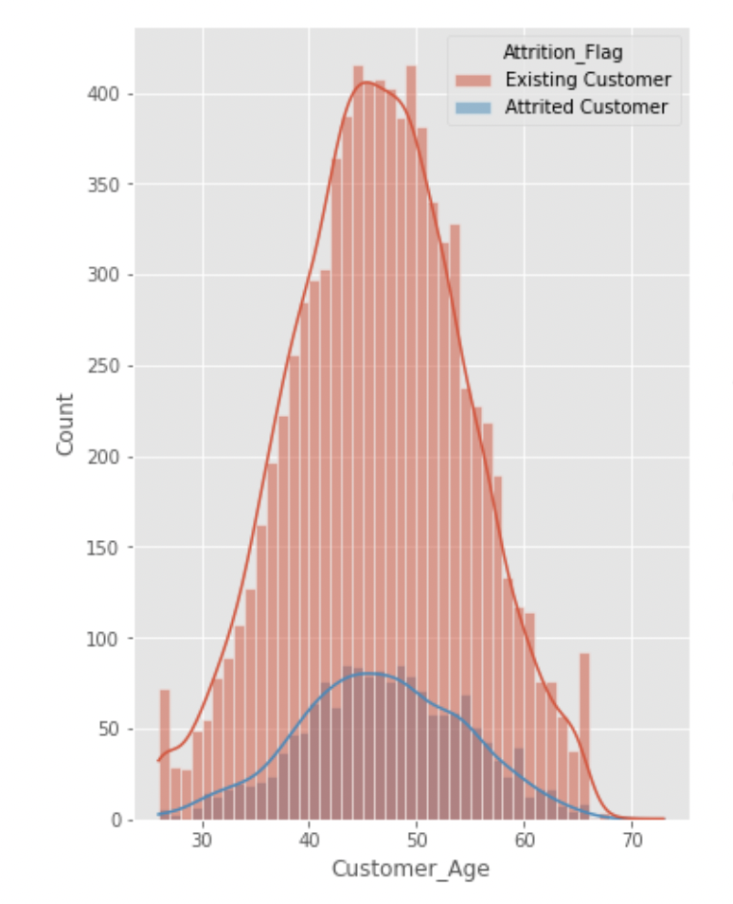
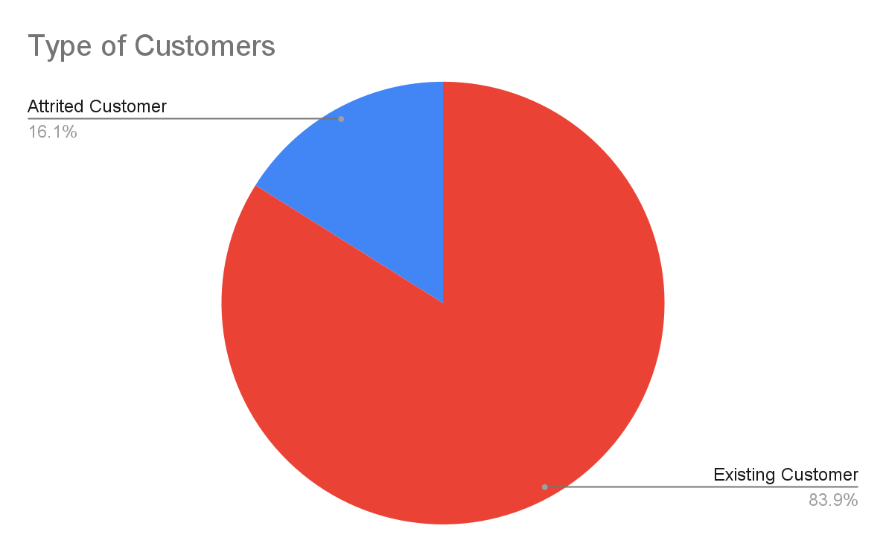
Data Exploration

Slide 9
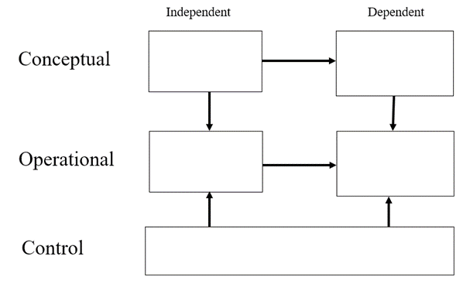
Good service provided by bank
Churning of customers (leave or not)
No. of months inactive in the last 12 months
Attrited Customers
Age, Education, Marital Status, Income, credit_limit, avg_utilization_ratio, total_trans_ct
Notes:
we will run Linear regression based on these framework

Slide 10
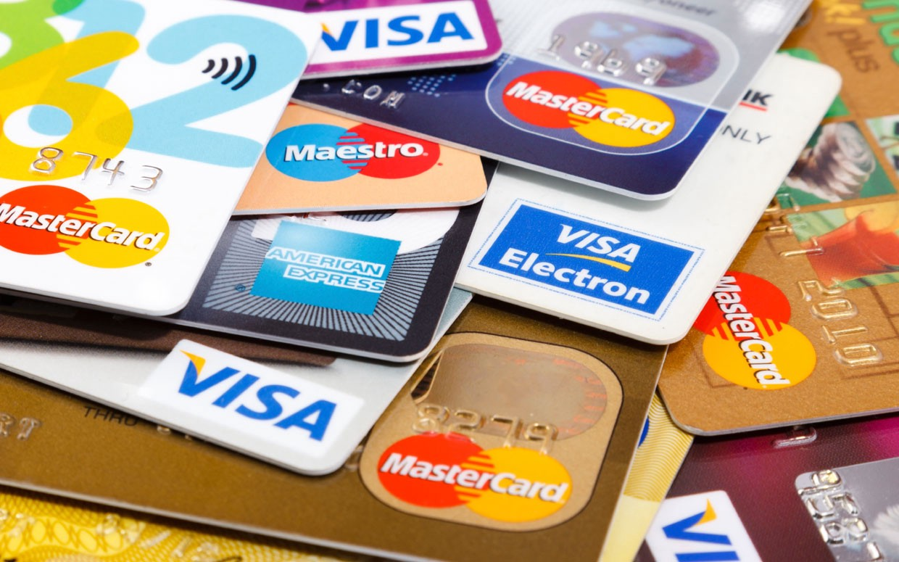
Thank You
MERCURY
Mercury is the closest planet to the Sun and the smallest one

